Slide 1
Lesson 01 Introduction to Statistics and Probability Concepts E214 – Statistical Methods for Engineering

Slide 2
E214 – Statistical Methods for Engineering
Inferential Statistics
Hypothesis Testing
Parameter Estimation
Organise & summarise data collected
Probability and Distributions
Venn Diagram
Probability Distributions
Descriptive Statistics
Conditional Probability
Discrete Random Variables and Probability Distributions
Continuous Random Variables and Probability Distributions
Binomial Distribution
Poisson Distribution
Normal Distribution
Exponential Distribution
L01
A more detailed topic tree on Hypothesis Testing will be given from L08 onwards

Slide 3
Overview of Concepts
S/N | Concepts | Slide Number
1 | Introduction to Statistics, Descriptive vs Inferential Statistics | 4-5
2 | Measures of Central Tendency (Mean, Median, Mode) | 6-8
3 | Shape of Data Distribution | 9
4 | Measures of Dispersion (Range, Variance, Standard Deviation, Interquartile Range) and calculation of Percentiles, Quartiles | 10-17
5 | Graphical Display Tools (Box Plot, Scatter Diagram, Time Series Plot) | 18-24
6 | Random Experiment, Sample Space, Sample Point, Event and Venn Diagram | 25-44

Slide 4
Introduction to Statistics
Statistics deals with the collection, processing, analysing, and interpretation of data.
Statistics provides a basis for assessing and drawing a conclusion.
The basic idea behind statistical methods of data analysis is to make inferences about a population by studying a relatively small representative sample chosen from it.
Statistics plays a critical role in the improvement of the quality of any product or service. It enables engineers to understand phenomena subject to variation and to effectively predict or control them.
Statistics can be further classified as “descriptive statistics” and “inferential statistics”.

Slide 5
Descriptive vs. Inferential Statistics
L01
Descriptive Statistics
Enable understanding of important features or provide insight into the data through summary measures of central tendency and dispersion and graphical representations
Purpose is to organise and summarise the data collected into some meaningful forms that are more easily understood
Examples:
Charts, graphs, plots, measures of central tendency (mean, median, mode), measures of dispersion (range, variance, standard deviation), frequency etc.
Inferential Statistics
Consists of:
Making claims about a population from representative sample data collected from the population
Performing estimations about the population characteristics (e.g. population mean and variance) and making predictions
Determining the relationships among variables
Examples:
Hypothesis testing, ANOVA, correlation analysis etc

Slide 6
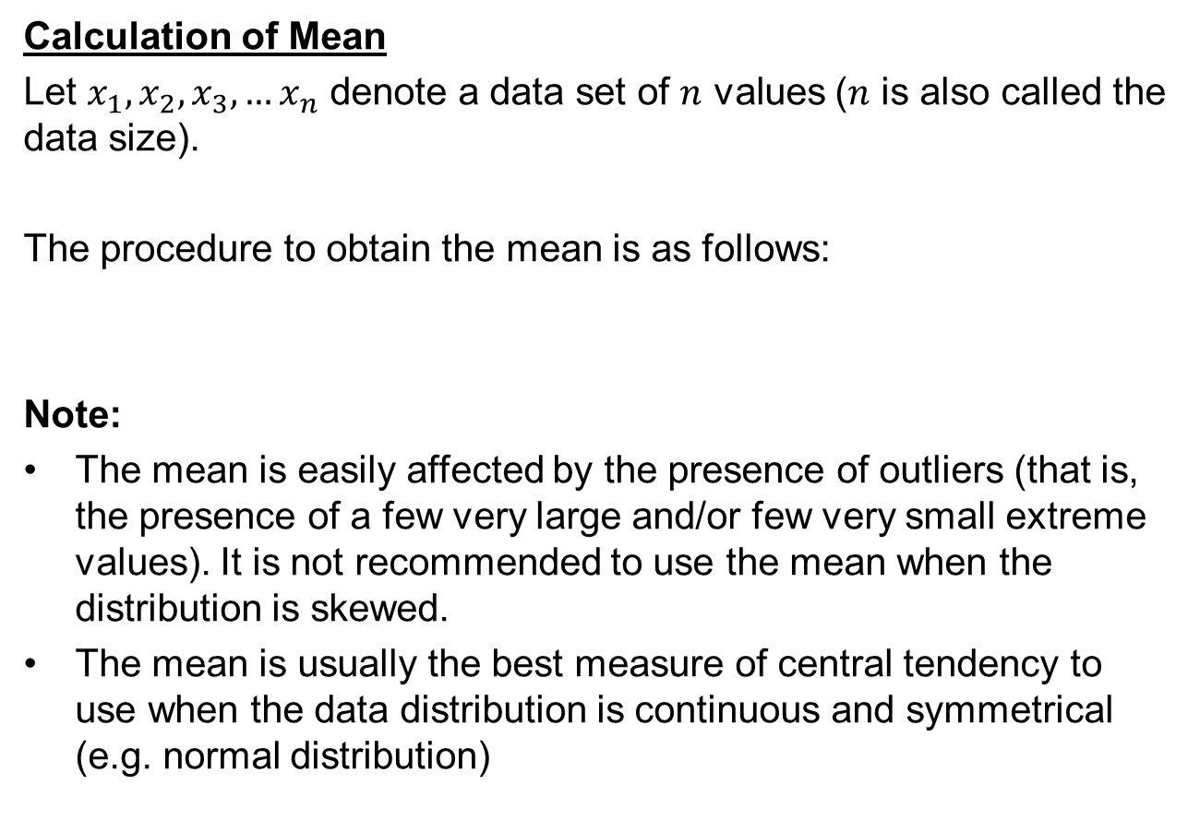
Measures of Central Tendency (Mean)
Calculation of Mean
Let $x_{1},x_{2},x_{3},…x_{n}$ denote a data set of $n$ values ($n$ is also called the data size).
The procedure to obtain the mean is as follows:
Note:
The mean is easily affected by the presence of outliers (that is, the presence of a few very large and/or few very small extreme values). It is not recommended to use the mean when the distribution is skewed.
The mean is usually the best measure of central tendency to use when the data distribution is continuous and symmetrical (e.g. normal distribution)

Slide 7

Measures of Central Tendency (Median)
Determination of Median
The median is the middle data value, after all the data values have been arranged from smallest to largest.
The procedure to obtain the median is as follows:
Arrange all the $n$ data values from smallest to largest (i.e. in ascending order).
If $n$ is an even number, then
Median =
If $n$ is an odd number, then
Median = Data value at ( )^{th} position
Note:
The median is not affected by the presence of outliers. It is usually preferred to other measures of central tendency when the data set is skewed or when dealing with ordinal data.
Notes:
Ordinal data: a categorical, statistical data type where the variables have natural, ordered categories
Examples of ordinal data are often found in questionnaires: for example, the survey question "Is your general health poor, reasonable, good, or excellent?" may have those answers coded respectively as 1, 2, 3, and 4. Sometimes data on an interval scale or ratio scale are grouped onto an ordinal scale: for example, individuals whose income is known might be grouped into the income categories $0-$19,999, $20,000-$39,999, $40,000-$59,999, ..., which then might be coded as 1, 2, 3, 4, .... Other examples of ordinal data include socioeconomic status, military ranks, and letter grades for coursework.

Slide 8
Measures of Central Tendency (Mode)
Determination of Mode
The mode is the data value that appears the most number of times in the data set.
Note:
There can be no mode, one mode, or more than one mode.
It will be easier to determine the mode if the data set has been arranged in ascending order first.
The mode is not affected by the presence of outliers.
The mode is the best measure of central tendency to use when dealing with nominal data.
Notes:
Nominal data contain two or more categories, but which do not have an intrinsic order.
For example, a real estate agent could classify their types of property into distinct categories such as houses, condos, co-ops or bungalows. So "type of property" is a nominal variable with 4 categories called houses, condos, co-ops and bungalows. Of note, the different categories of a nominal variable can also be referred to as groups or levels of the nominal variable. Another example of a nominal variable would be classifying where people live in the USA by state. In this case there will be many more levels of the nominal variable (50 in fact).

Slide 9
Shapes of the data distribution
Describes how the data is distributed
Types of shapes
Symmetric or Skewed
Skewness is a measure of the asymmetry of the probability distribution of a real-valued random variable.
A negative skew indicates that the tail on the left side of the probability density function is longer than the right side, i.e., left-skewed;
A positive skew indicates that the tail on the right side is longer than the left side, i.e., right-skewed.
Left-Skewed
Symmetric
Right-Skewed
Mean < Median < Mode
Mean = Median =Mode
Mode < Median < Mean

Slide 10
Measures of Dispersion
Mean, median and mode are measures of central tendency which indicate where the data is centrally located in that data set. To determine the spread of the data, we need to use measures of dispersion.
There are several measures of dispersion, such as the range, variance, standard deviation, and interquartile range.
Notes:
Why is it important to determine the spread of the data set?
A measure of spread gives us an idea of how well the mean, for example, represents the data. If the spread of values in the data set is large, the mean is not as representative of the data as if the spread of data is small. This is because a large spread indicates that there are probably large differences between individual scores.
Measures of dispersion are also called averages of the ‘second order i,e., second time averaging the deviations from a measure of central tendency. It affords an estimate of the phenomena to which the given (original) data relate. This will increase the accuracy of statistical analysis and interpretation and we can be in a position to draw more dependable inferences.
Measures of dispersion serve as a useful check on drawing wrong conclusions from the comparison of averages or measures of central tendency. Measures of dispersion are of great value in our statistical analysis provided relatives (coefficients of dispersions) are put into practice. Otherwise, conclusions drawn will not be dependable and reliable to a great extent.

Slide 11
Measures of Dispersion (Range)
The range of a data set is the easiest to determine, as it is the difference between the largest and smallest data values.
Range = maximum data value – minimum data value
[Example]
Compute the range of each data set.
[Solution]
For Data Set 1, Range = 68 – 32 = 36
For Data Set 2, Range = 80 – 18 = 62
Data Set 1:
68 | 40 | 36 | 33 | 42 | 53 | 32
Data Set 2:
20 | 18 | 32 | 42 | 20 | 40 | 58 | 80

Slide 12
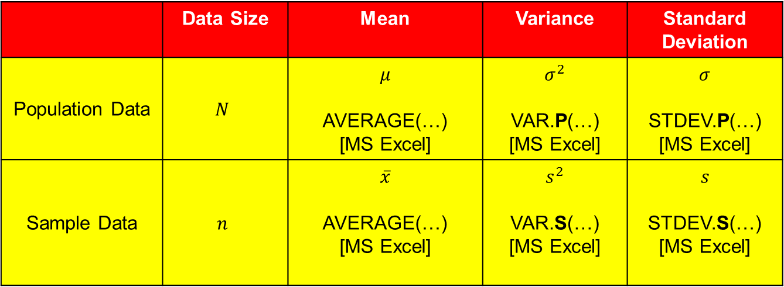
Measures of Dispersion (Variance, Standard Deviation)
The following table shows the different notations of mean, variance and standard deviation for population and sample data:
 | Data Size | Mean | Variance | Standard Deviation
Population Data | $$N$$ | $$μ$$ AVERAGE(…) [MS Excel] | $$σ^{2}$$ VAR.P(…) [MS Excel] | $$σ$$ STDEV.P(…) [MS Excel]
Sample Data | $$n$$ | $$\overline{x}$$ AVERAGE(…) [MS Excel] | $$s^{2}$$ VAR.S(…) [MS Excel] | $$s$$ STDEV.S(…) [MS Excel]
Note:
Population variance,
Sample variance, [also called “unbiased” sample variance]
Standard deviation =
Notes:
When to use the sample or population standard deviation
We are normally interested in knowing the population standard deviation because our population contains all the values we are interested in. Therefore, you would normally calculate the population standard deviation if: (1) you have the entire population or (2) you have a sample of a larger population, but you are only interested in this sample and do not wish to generalize your findings to the population. However, in statistics, we are usually presented with a sample from which we wish to estimate (generalize to) a population, and the standard deviation is no exception to this. Therefore, if all you have is a sample, but you wish to make a statement about the population standard deviation from which the sample is drawn, you need to use the sample standard deviation.
Confusion can often arise as to which standard deviation to use due to the name "sample" standard deviation incorrectly being interpreted as meaning the standard deviation of the sample itself and not the estimate of the population standard deviation based on the sample.

Slide 13
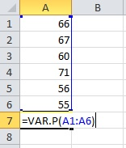
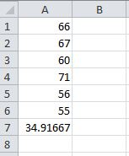
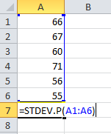
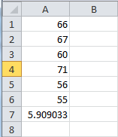
Computing Variance and Standard Deviation in MS Excel
An illustration of using Excel to compute variance and standard deviation:

Slide 14
Percentile, Quartile, and Interquartile range
A percentile is the data value below which a certain percentage of all the data observation values fall. So the 20th percentile is the value below which 20 percent of the observations may be found.
The quartiles are the 25th, 50th and 75th percentiles
First (lower) quartile Q₁ = 25th percentile
Second quartile Q₂ = 50th percentile
Third (upper) quartile Q₃ = 75th percentile
Second quartile is equal to the median
[Example]
Percentiles are often used to interpret scores on standardized tests (GRE, GMAT etc.). If a student is informed that her score is on the 70th percentile, this means that 70 percent of students who took the test received lower scores than her.

Slide 15

Percentile, Quartile, and Interquartile range
Determination of the 100p^{th} percentile
Consider a data set of n values.
Procedures to obtain the 100p^{th} percentile are as follows (e.g. if we need to find 60th percentile, then ):
Arrange the data values in ascending order.
Compute the value of n × p:
If n × p is not an integer, round it up to the next integer, say m.
Percentile = Data value at the mth position
If n × p is an integer, say k, then
Percentile =
Interquartile Range, IQR = Third Quartile – First Quartile
= $Q_{3}−Q_{1}$

Slide 16

Example: Percentile, Quartile, and Interquartile range
A data set is given as follows:
40 | 25 | 23 | 38 | 31 | 24 | 21 | 5
6 | 50 | 14 | 47 | 49 | 49 | 33 | 43
Determine its
70th percentile, and
first quartile, $Q_{1}$.

Slide 17

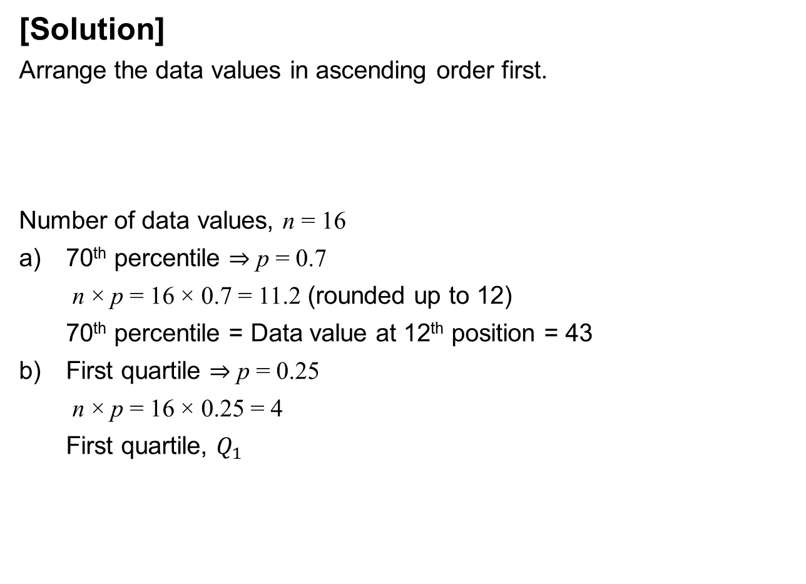
Example: Percentile, Quartile, and Interquartile range
[Solution]
Arrange the data values in ascending order first.
Number of data values, n = 16
70th percentile $⇒$ p = 0.7
n × p = 16 × 0.7 = 11.2 (rounded up to 12)
70th percentile = Data value at 12th position = 43
First quartile $⇒$ p = 0.25
n × p = 16 × 0.25 = 4
First quartile, $Q_{1}$
5 | 6 | 14 | 21 | 23 | 24 | 25 | 31
33 | 38 | 40 | 43 | 47 | 49 | 49 | 50
5 6 14 21 23 24 25 31 33 38 40 43 47 49 49 50
70th percentile
5 6 14 21 23 24 25 31 33 38 40 43 47 49 49 50
$$Q_{1}$$
Notes:
Lecturer to consider discussing the interpretation of 70th percentile and first quartile

Slide 18
Graphical Display Tools (Box Plot)
A box plot presents the median (second quartile), first and third quartiles, and outliers (if any). It can be used to compare samples.
The box plot has two parts of the box, each representing one quarter of the data.
The box plot also has two whiskers.
The “whiskers” extend from the top and the bottom of the box and end at the most extreme data point that is not an outlier.
Outliers are those data values that lie more than “1.5 IQR below the first quartile” or “1.5 IQR above the third quartile”.
How to use Excel for Box Plot? http://www.youtube.com/watch?v=wvR3q41Pneo

Slide 19

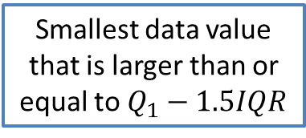
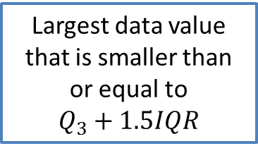

Anatomy of a Box Plot
Largest data value that is smaller than or equal to
$$Q_{3}+1.5IQR$$
X
Third Quartile, $Q_{3}$
Median
Outliers
First Quartile, $Q_{1}$
Smallest data value that is larger than or equal to $Q_{1}−1.5IQR$
X
X
[Taken from Navidi W., Statistics for Engineers and Scientists]

Slide 20
Example: Box Plot
Based on the data above, which is in ascending order, it is given that
Q₁ = 50, Median = 54.5, Q₃ = 58
Which data value(s) are outlier(s)? [Hint: Consider computing the values of the end-points of the box plot.]
?
58
54.5
50
?
Notes:
Conduct using a polling platform (e.g. LEO or other online websites that you know) and encourage all students to participate. Do regular refreshing of polling results. Entire activity can take 5-8 minutes. Encourage students to share their workings to the class.

Slide 21
Example: Box Plot
[Solution]
IQR = Q₃ – Q₁ = 58 – 50 = 8
1.5 * IQR = 1.5*8 = 12
Q₁ - 1.5 IQR = 50 – 12 = 38
(The smallest data value that is larger than Q₁ - 1.5 IQR = 42)
Q₃ + 1.5 IQR = 58 + 12 = 70
(The largest data value that is smaller than Q₃ + 1.5 IQR = 68)
Hence, 71 is the outlier.
71
X
68
58
54.5
50
42

Slide 22
Box Plot and Distribution Shape
Left-Skewed
Symmetric
Right-Skewed
Q₁
Q₂
Q₃
Q₁
Q₂
Q₃
Q₁
Q₂
Q₃
Q₁
Q₂
Q₃
Q₁
Q₂
Q₃
Q₁
Q₂
Q₃

Slide 23
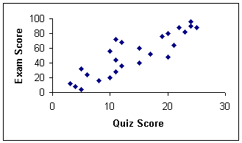
Graphical Display Tools (Scatter Diagram)
Different variables are plotted on different axes
Show whether a relationship exists between 2 variables
Using Excel: https://support.office.com/en-US/article/Present-your-data-in-a-scatter-chart-or-a-line-chart-4570A80F-599A-4D6B-A155-104A9018B86E

Slide 24
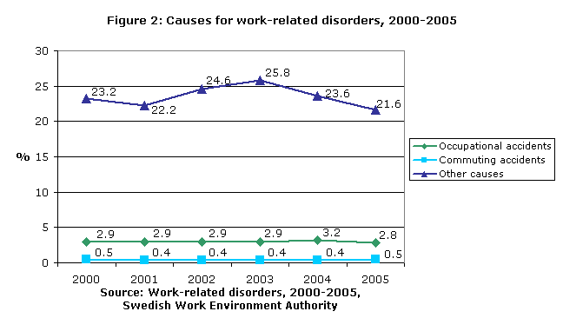
Graphical Display Tools (Time Series Plot)
Also known as the line graph or run chart
Displays data in a time sequence for a given period of time
Used to monitor whether there is a systematic change of the data over time (trend)
Using Excel: https://support.office.com/en-US/article/Present-your-data-in-a-scatter-chart-or-a-line-chart-4570A80F-599A-4D6B-A155-104A9018B86E

Slide 25
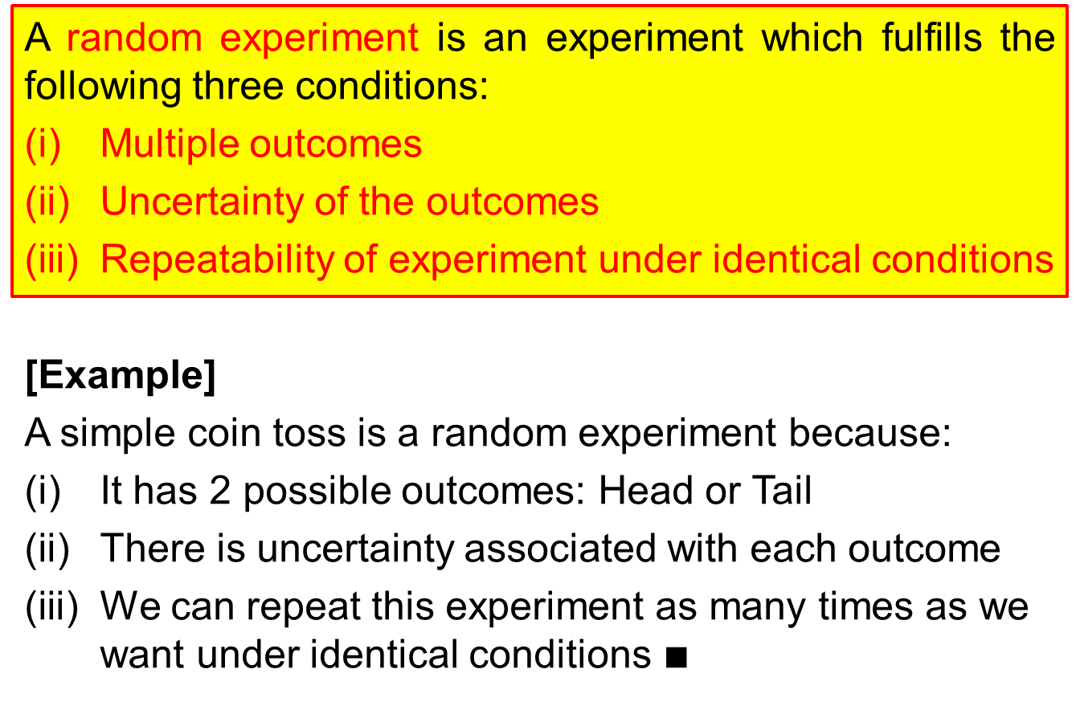
Random Experiment
A random experiment is an experiment which fulfills the following three conditions:
Multiple outcomes
Uncertainty of the outcomes
Repeatability of experiment under identical conditions
[Example]
A simple coin toss is a random experiment because:
It has 2 possible outcomes: Head or Tail
There is uncertainty associated with each outcome
We can repeat this experiment as many times as we want under identical conditions $∎$

Slide 26
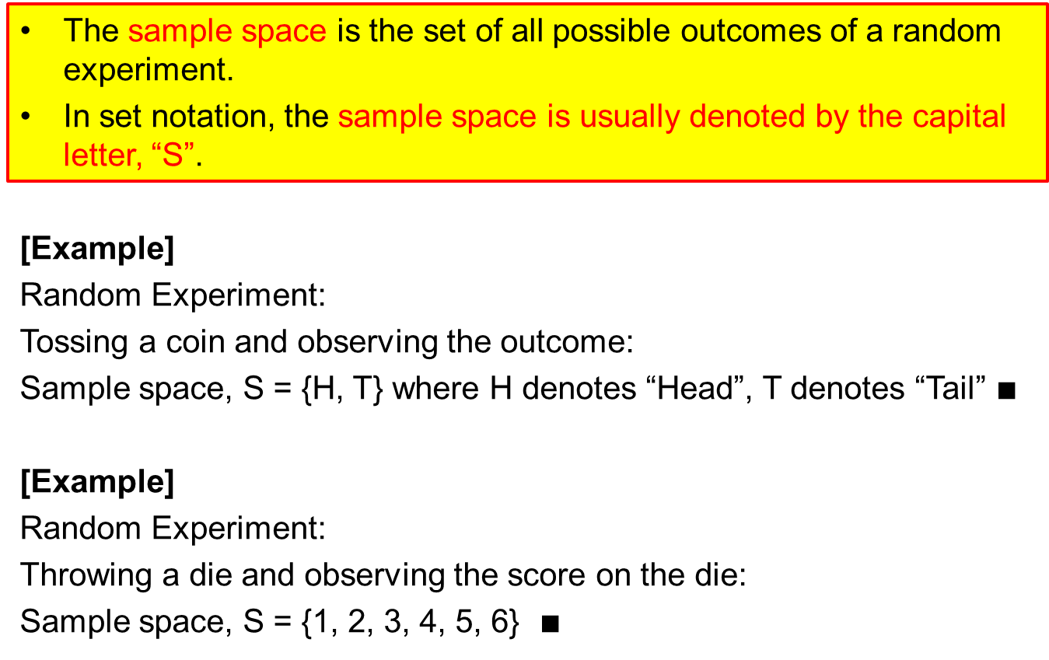
Sample Space
The sample space is the set of all possible outcomes of a random experiment.
In set notation, the sample space is usually denoted by the capital letter, “S”.
[Example]
Random Experiment:
Tossing a coin and observing the outcome:
Sample space, S = {H, T} where H denotes “Head”, T denotes “Tail” $∎$
[Example]
Random Experiment:
Throwing a die and observing the score on the die:
Sample space, S = {1, 2, 3, 4, 5, 6} $∎$

Slide 27
Sample Point and Event
A sample point is a particular outcome of a sample space, S.
An event is a subset of the sample space, S.
An event is denoted by a capital letter, such as A, B, C,…etc. Do note, however, that S is reserved for the sample space. We write “ ” to mean “Event A is a subset of S”, which means every element inside A also lies inside S.
[Example]
Consider the random experiment of rolling two
dice and recording the sum of the scores on the two dice
Sample space, S = {2,3,4,5,6,7,8,9,10,11,12}
The outcome “6” is a sample point of the sample space, S.
Let A be the event “total score on the two dice is even”. Therefore,
A = {2,4,6,8,10,12}. Notice that A is a subset of S.
S
A
Venn Diagram

Slide 28
Probability of an Event
Given a finite sample space from a random experiment, the probability of an event A happening is denoted by P(A). For any event A, 0 ≤ P(A) ≤ 1.
P(A) is determined using the following formula:
, where
n(A) = number of sample points in event A
n(S) = total number of sample points in sample space S
Note: This formula applies only to random experiments with equally likely outcomes.
[Example]
Random experiment: Throwing a fair dice and observing the score. Sample space, S ={1,2,3,4,5,6}
Let A be event “score is even and more than 3”
A={4,6}
It is important that the dice is fair so that each outcome is equally likely to occur.

Slide 29
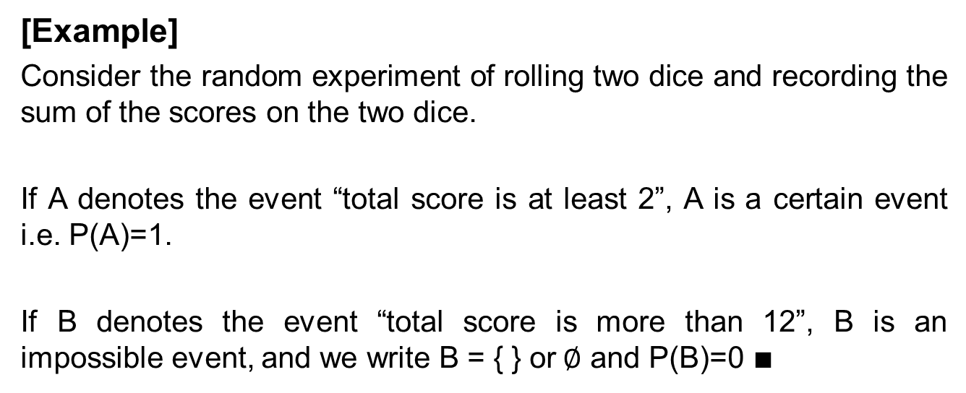
Certain and Impossible Events
A certain event is an event that is guaranteed to happen. An example would be sample space S, i.e. P(S) = 1 because S contains all possible outcomes of a random experiment, and for sure one of these outcomes will happen.
An impossible event is an event that will never happen. It is denoted by the null set, { } or ∅. The null set does not contain any elements at all. P(∅) = 0.
[Example]
Consider the random experiment of rolling two dice and recording the sum of the scores on the two dice.
If A denotes the event “total score is at least 2”, A is a certain event i.e. P(A)=1.
If B denotes the event “total score is more than 12”, B is an impossible event, and we write B = { } or ∅ and P(B)=0 $∎$

Slide 30
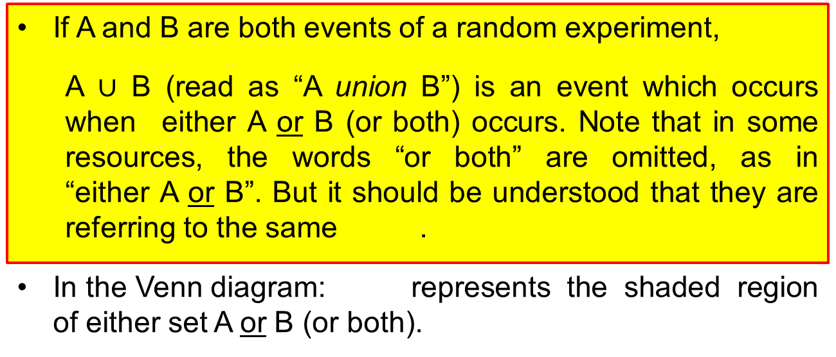
Union of Two Events
If A and B are both events of a random experiment,
A $∪$ B (read as “A union B”) is an event which occurs when either A or B (or both) occurs. Note that in some resources, the words “or both” are omitted, as in “either A or B”. But it should be understood that they are referring to the same .
In the Venn diagram: represents the shaded region of either set A or B (or both).
S
A
B

Slide 31
Intersection of Two Events
If A and B are both events of a random experiment,
(read as “A intersect B”) is an event which occurs when both A and B occur simultaneously.
In the Venn diagram: represents the shaded common, overlapping region between sets A and B.
S
A
B

Slide 32
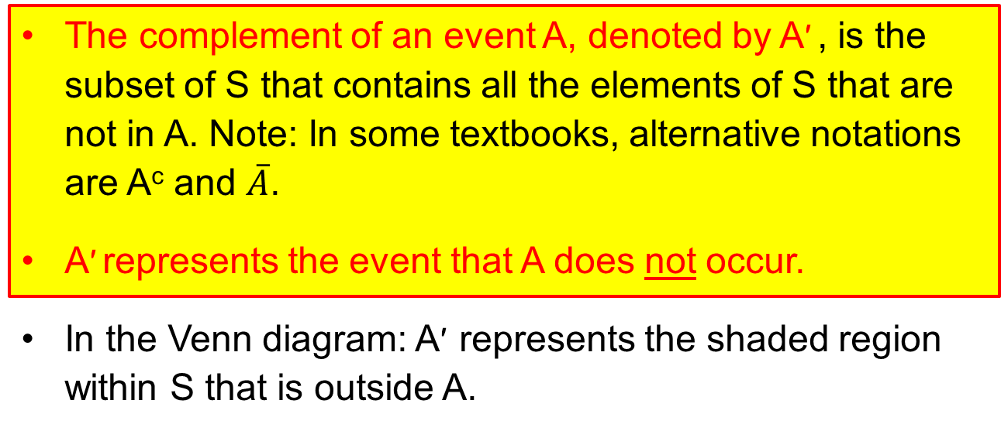
Complement of an Event
The complement of an event A, denoted by A′ , is the subset of S that contains all the elements of S that are not in A. Note: In some textbooks, alternative notations are A^{c} and $\overline{A}$.
A′ represents the event that A does not occur.
In the Venn diagram: A′ represents the shaded region within S that is outside A.
S
A
A′

Slide 33
Mutually Exclusive Events
The events A and B are said to be mutually exclusive if they cannot happen together at the same time. In the Venn diagram, sets representing mutually exclusive events have no elements (outcomes) in common, i.e. or ∅ if A and B are mutually exclusive.
[Example]
It is impossible that tossing a coin can show both head and tail at the same time. The events “coin shows a head” and “coin shows a tail” are mutually exclusive for a single coin toss random experiment.
S
A
B
Mutually exclusive events A and B are represented by non-overlapping sets in the Venn diagram.

Slide 34
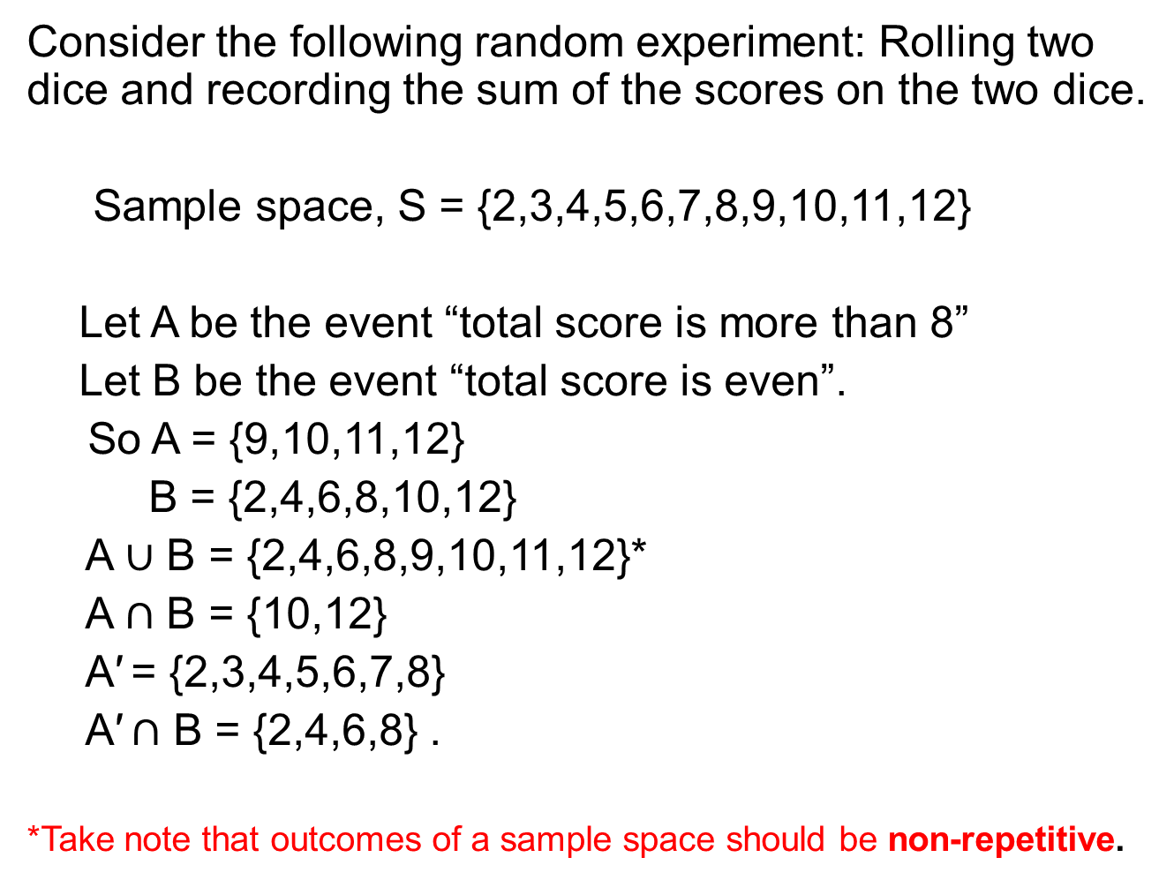
Example: Events
Consider the following random experiment: Rolling two dice and recording the sum of the scores on the two dice.
Sample space, S = {2,3,4,5,6,7,8,9,10,11,12}
Let A be the event “total score is more than 8”
Let B be the event “total score is even”.
So A = {9,10,11,12}
B = {2,4,6,8,10,12}
A $∪$ B = {2,4,6,8,9,10,11,12}*
A $∩$ B = {10,12}
A′ = {2,3,4,5,6,7,8}
A′ $∩$ B = {2,4,6,8} .
*Take note that outcomes of a sample space should be non-repetitive.

Slide 35
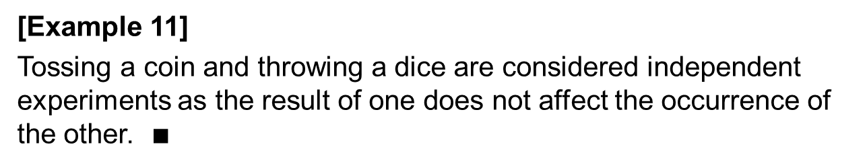
Independent Events
Two events are independent if and only if the happening or non-happening of an event does not affect the occurrence of the other event.
Suppose two cards are drawn from a shuffled deck of poker cards.
If the cards are drawn with replacement, i.e. the first card is drawn, then replaced, and the second card is drawn, then the two events are independent as the result of the second draw does not depend on the first draw.
If the cards are drawn without replacement, i.e. the first card is drawn, not replaced, and the second card is drawn, then the two events are dependent since the result of the second draw is affected by the result of the first draw.
[Example 11]
Tossing a coin and throwing a dice are considered independent experiments as the result of one does not affect the occurrence of the other. $∎$

Slide 36
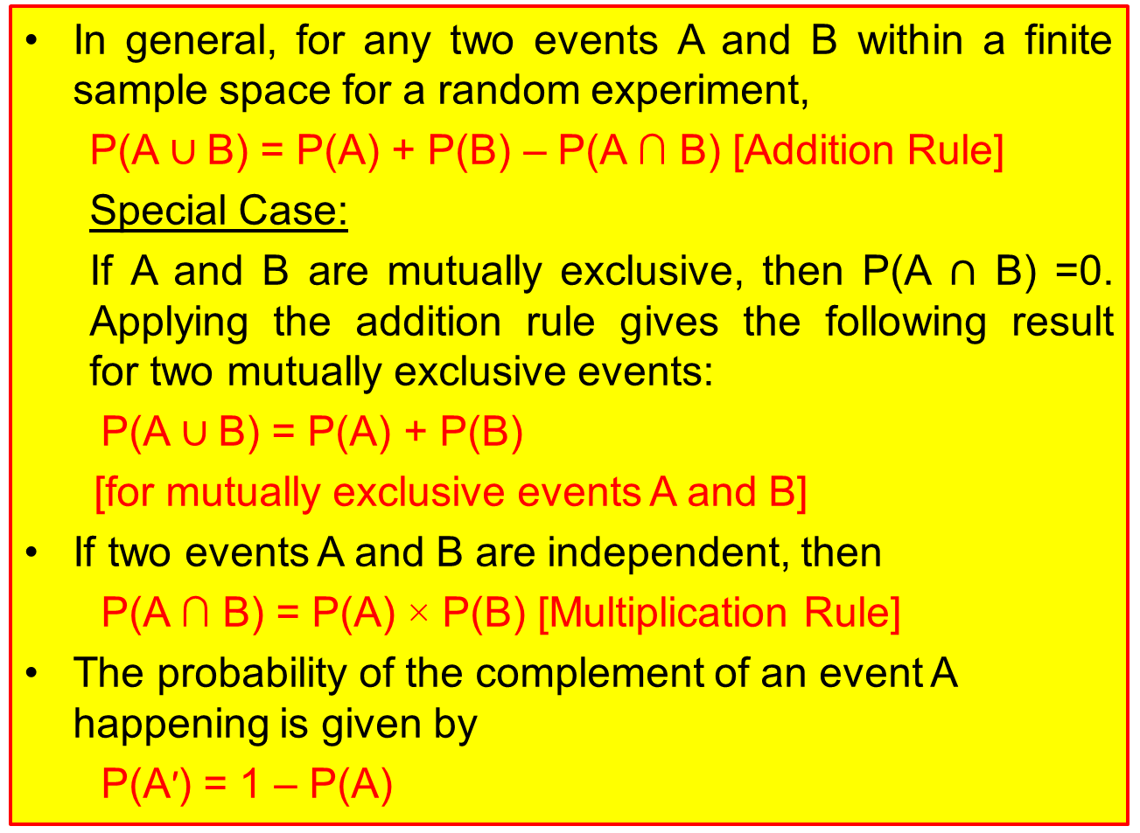
Some Important Results in Probability Theory
In general, for any two events A and B within a finite sample space for a random experiment,
P(A ∪ B) = P(A) + P(B) – P(A ∩ B) [Addition Rule]
Special Case:
If A and B are mutually exclusive, then P(A $∩$ B) =0. Applying the addition rule gives the following result for two mutually exclusive events:
P(A ∪ B) = P(A) + P(B)
[for mutually exclusive events A and B]
If two events A and B are independent, then
P(A ∩ B) = P(A) × P(B) [Multiplication Rule]
The probability of the complement of an event A happening is given by
P(A′) = 1 – P(A)

Slide 37
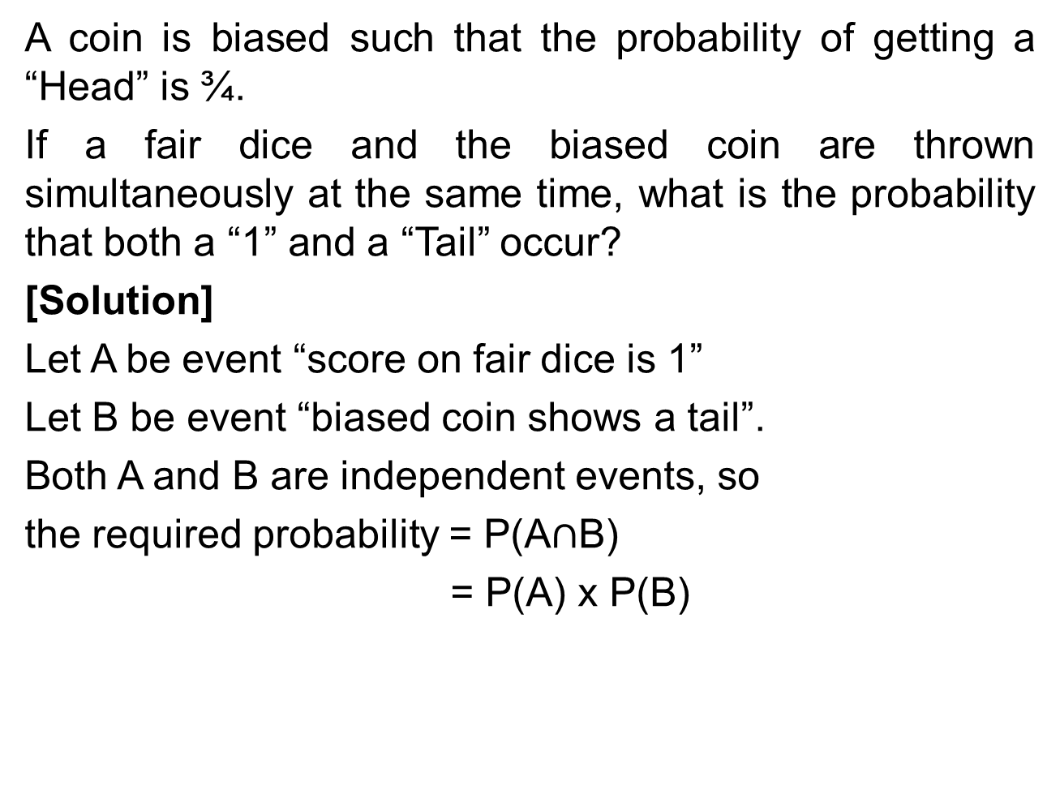
Example 12: Independent Events
A coin is biased such that the probability of getting a “Head” is ¾.
If a fair dice and the biased coin are thrown simultaneously at the same time, what is the probability that both a “1” and a “Tail” occur?
[Solution]
Let A be event “score on fair dice is 1”
Let B be event “biased coin shows a tail”.
Both A and B are independent events, so
the required probability = P(A$∩$B)
= P(A) x P(B)

Slide 38
Example: Venn Diagram
Three ball games (basketball, football, and volleyball) are available for a class of 35 students to choose as CCAs. 15 students chose basketball, 25 students chose football, 10 students chose volleyball, 8 students chose both basketball and football, 5 students chose both basketball and volleyball, 7 students chose both football and volleyball, and 2 students chose all three games.
Draw the Venn diagram with all figures labelled.
Determine how many students chose none of the games as CCA.
If one student is randomly chosen from the class, calculate the probability that
the student chose both basketball and football as CCA.
the student chose either basketball or football as CCA.
the student chose basketball but not football.

Slide 39
Example: Venn Diagram
Three ball games (basketball, football, and volleyball) are available for a class of 35 students to choose as CCAs. 15 students chose basketball, 25 students chose football, 10 students chose volleyball, 8 students chose both basketball and football, 5 students chose both basketball and volleyball, 7 students chose both football and volleyball, and 2 students chose all three games.
Draw the Venn diagram with all figures labelled.
Denote B as Basketball, F as Football,
V as Volleyball and S as sample space.
S
B
F
V

Slide 40
Example: Venn Diagram
Three ball games (basketball, football, and volleyball) are available for a class of 35 students to choose as CCAs. 15 students chose basketball, 25 students chose football, 10 students chose volleyball, 8 students chose both basketball and football, 5 students chose both basketball and volleyball, 7 students chose both football and volleyball, and 2 students chose all three games.
Draw the Venn diagram with all figures labelled.
Firstly, fill in the number of students who
chose all three games.
Next, calculate the number of students who
chose basketball and football only as
8 – 2 = 6.
S
B
F
6
2
V

Slide 41
Example: Venn Diagram
Three ball games (basketball, football, and volleyball) are available for a class of 35 students to choose as CCAs. 15 students chose basketball, 25 students chose football, 10 students chose volleyball, 8 students chose both basketball and football, 5 students chose both basketball and volleyball, 7 students chose both football and volleyball, and 2 students chose all three games.
Draw the Venn diagram with all figures labelled.
Similarly, the number of students who
chose basketball and volleyball only is
5 – 2 = 3, and the number of students who
chose football and volleyball only is
7 – 2 = 5.
S
B
F
6
2
3
5
V

Slide 42
Example: Venn Diagram
Three ball games (basketball, football, and volleyball) are available for a class of 35 students to choose as CCAs. 15 students chose basketball, 25 students chose football, 10 students chose volleyball, 8 students chose both basketball and football, 5 students chose both basketball and volleyball, 7 students chose both football and volleyball, and 2 students chose all three games.
Draw the Venn diagram with all figures labelled.
Next, the number of students who
chose basketball only is calculated as
15 – 2 – 6 – 3 = 4.
S
B
F
4
6
2
3
5
V

Slide 43
Example: Venn Diagram
Three ball games (basketball, football, and volleyball) are available for a class of 35 students to choose as CCAs. 15 students chose basketball, 25 students chose football, 10 students chose volleyball, 8 students chose both basketball and football, 5 students chose both basketball and volleyball, 7 students chose both football and volleyball, and 2 students chose all three games.
Draw the Venn diagram with all figures labelled.
Similarly, the number of students who
chose football only is calculated as
25 – 2 – 6 – 5 = 12.
The number of students who
chose volleyball only is calculated as
10 – 2 – 3 – 5 = 0.
S
B
F
4
6
12
2
3
5
0
V

Slide 44
Example: Venn Diagram
Three ball games (basketball, football, and volleyball) are available for a class of 35 students to choose as CCAs. 15 students chose basketball, 25 students chose football, 10 students chose volleyball, 8 students chose both basketball and football, 5 students chose both basketball and volleyball, 7 students chose both football and volleyball, and 2 students chose all three games.
Draw the Venn diagram with all figures labelled.
Lastly, the number of students who
chose none of the games as CCA is
calculated as
35 – 2 – 6 – 5 – 4 – 12 – 3 = 3.
S
B
F
4
6
12
2
3
5
0
3
V

Slide 45
Example 13: Venn Diagram
Three ball games (basketball, football, and volleyball) are available for a class of 35 students to choose as CCAs. 15 students chose basketball, 25 students chose football, 10 students chose volleyball, 8 students chose both basketball and football, 5 students chose both basketball and volleyball, 7 students chose both football and volleyball, and 2 students chose all three games.
Determine how many students chose none of the games as CCA.
3 students chose none of the games as
CCA.
S
B
F
4
6
12
2
3
5
0
3
V

Slide 46
Example 13: Venn Diagram
If one student is randomly chosen from the class, calculate the probability that
the student chose both basketball and football as CCA.
Probability
the students chose either basketball or football as CCA.
Probability
the student chose basketball but not football
Probability
S
B
F
4
6
12
2
3
5
0
3
V

Slide 47
Learning Objectives
Explain the difference between descriptive and inferential statistics
Select and use appropriate data display tools for given data
Interpret graphical display tools
Summarize data using measures of central tendency and dispersion and compare data using these summary measurements
Comprehend the concepts of random experiment, sample space, event, probability of an event, mutually exclusive events and independent events
Draw and interpret Venn diagrams to determine the unions, intersections, and complements of events and probabilities
Apply the addition rule in calculating probabilities
Apply the multiplication rule in calculating probabilities for independent events

Slide 48
E-Learning Videos
You are strongly encouraged to watch the e-learning video prepared for L01 to enhance your understanding of the main learning objectives.
You can access the e-learning videos from the following link:
https://drive.google.com/file/d/0B0VVo-P5cYtqNHpTUkp1M09Lc0k/edit?usp=sharing
https://drive.google.com/file/d/0B0VVo-P5cYtqVV9yQmNRUnVLMk0/edit?usp=sharing
You can also refer to some additional concepts related to this problem attached in Appendix:

